Slide 1
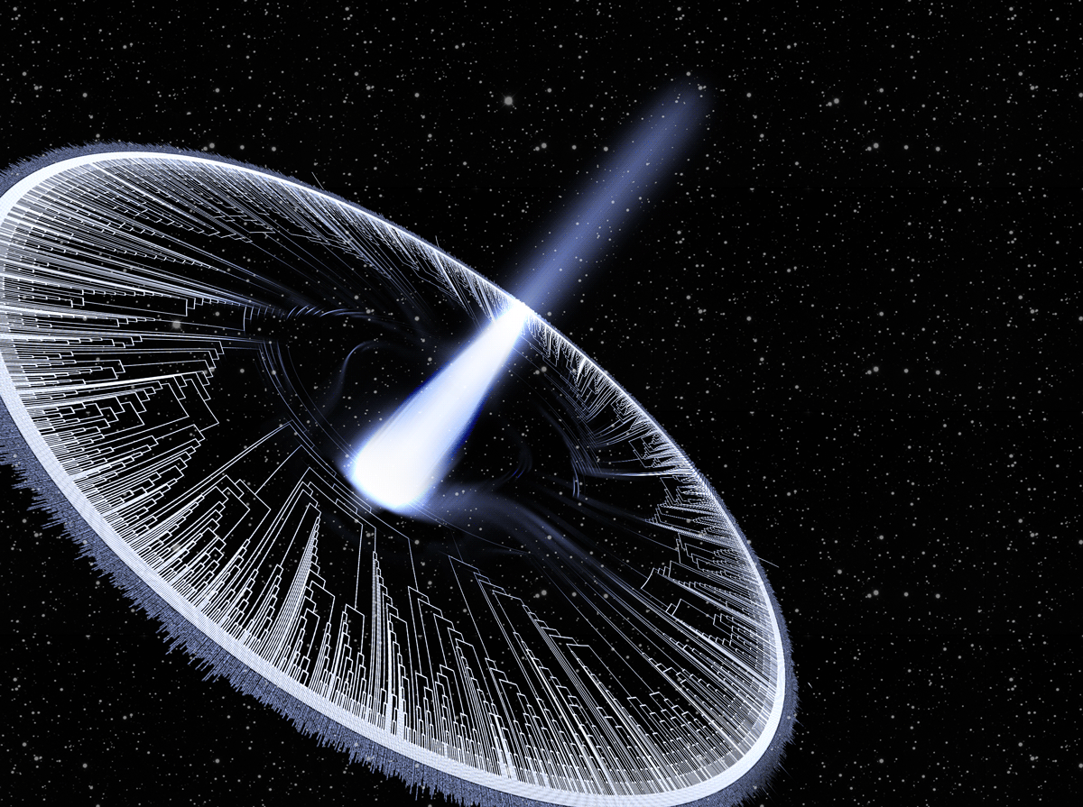
Macroevolution & Phylogenetics

Slide 2
Goals of the course:
1. Learn how to estimate trees
2. Learn how to use trees
3. Learn about the big questions in macroevolution
4. What are your goals?

Slide 3
Syllabus
Subject to change

Slide 4
Introductions
In the chat:
1. Your name, department, year, program
2. A hobby or interest outside your job
3. What topic you most want to learn about in this class.

Slide 5
Why phylogeny?
What does a phylogeny represent?
www.OneZoom.org/life/
www.pollev.com/josefuyeda941

Slide 6

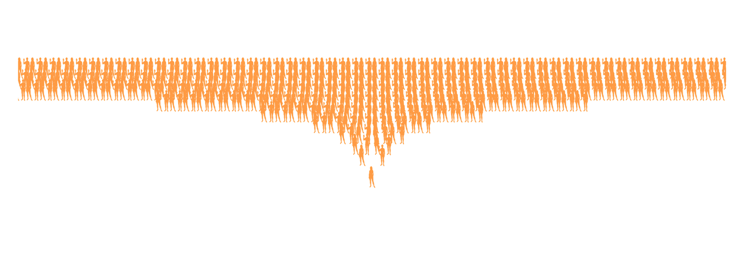
40 generations ago, you would have > 1 trillion ancestors
….2500 times the population 800 years ago

Slide 7
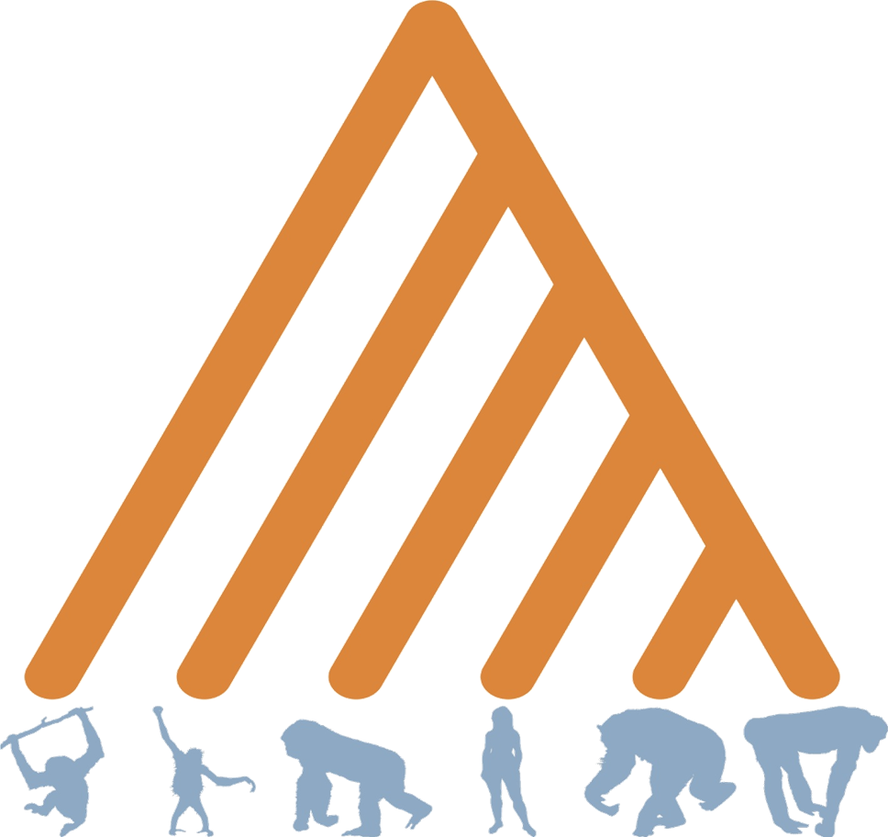

Slide 8
Breakout groups
1. A) Consider your personal family tree (i.e. a pedigree). You have 2 biological parents, 4 grandparents, 8 great grandparents and so on (suggesting the formula 21 parents, 22 grandparents, 23 great grandparents 2X X-fold great grandparents). Thus, your number of ancestors increases as you go back in time. Now consider a phylogeny. Rather than expanding as we go back in time, phylogenetic trees collapse, so that all life has a single ancestor. Both a pedigree and a phylogeny have tree-like branching structures, but they go in opposite directions. What explains this difference?
B) If we use the formula in the question A above we can get our number of ancestors after say, 25 generations (25 generations for humans is ~ 400-900 years). This would give each of us 225 > 33 billion individual ancestors 25 generations ago. Of course, 400-900 years ago the human population on earth was only about 400 million individuals. What explains this apparent conflict? Why is this explanation actually critical for our understanding of what phylogenies represent?
2. What are phylogenies? Are they a) hypotheses b) real facts that exist in nature or c) a metaphor? This is just something to think about, a full answer may take you too long to write, but put down your best thoughts in 1 short paragraph.

Slide 9
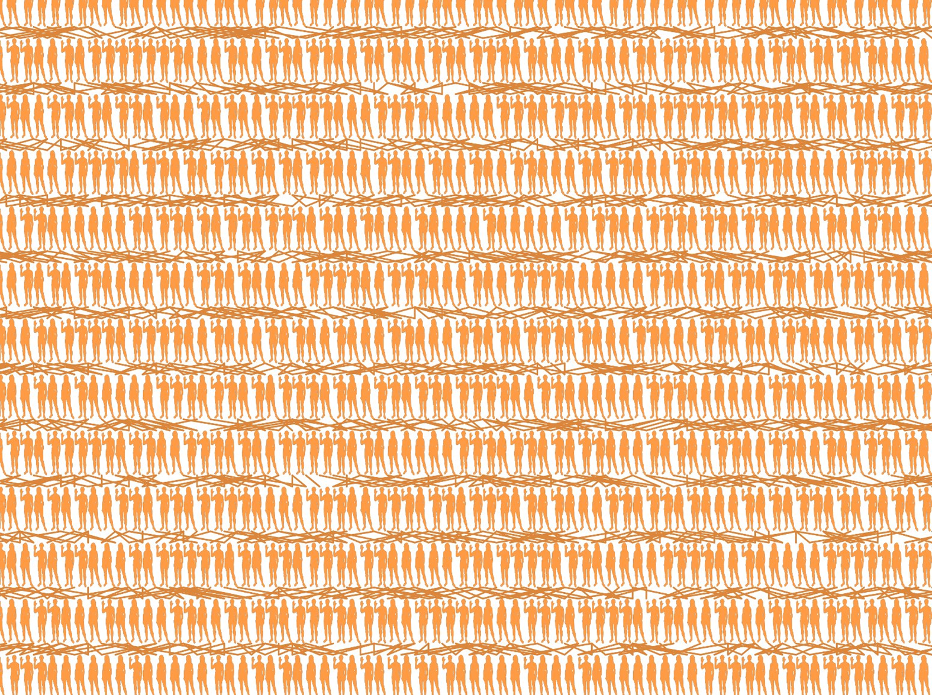

Slide 10
What happened here?

Slide 11
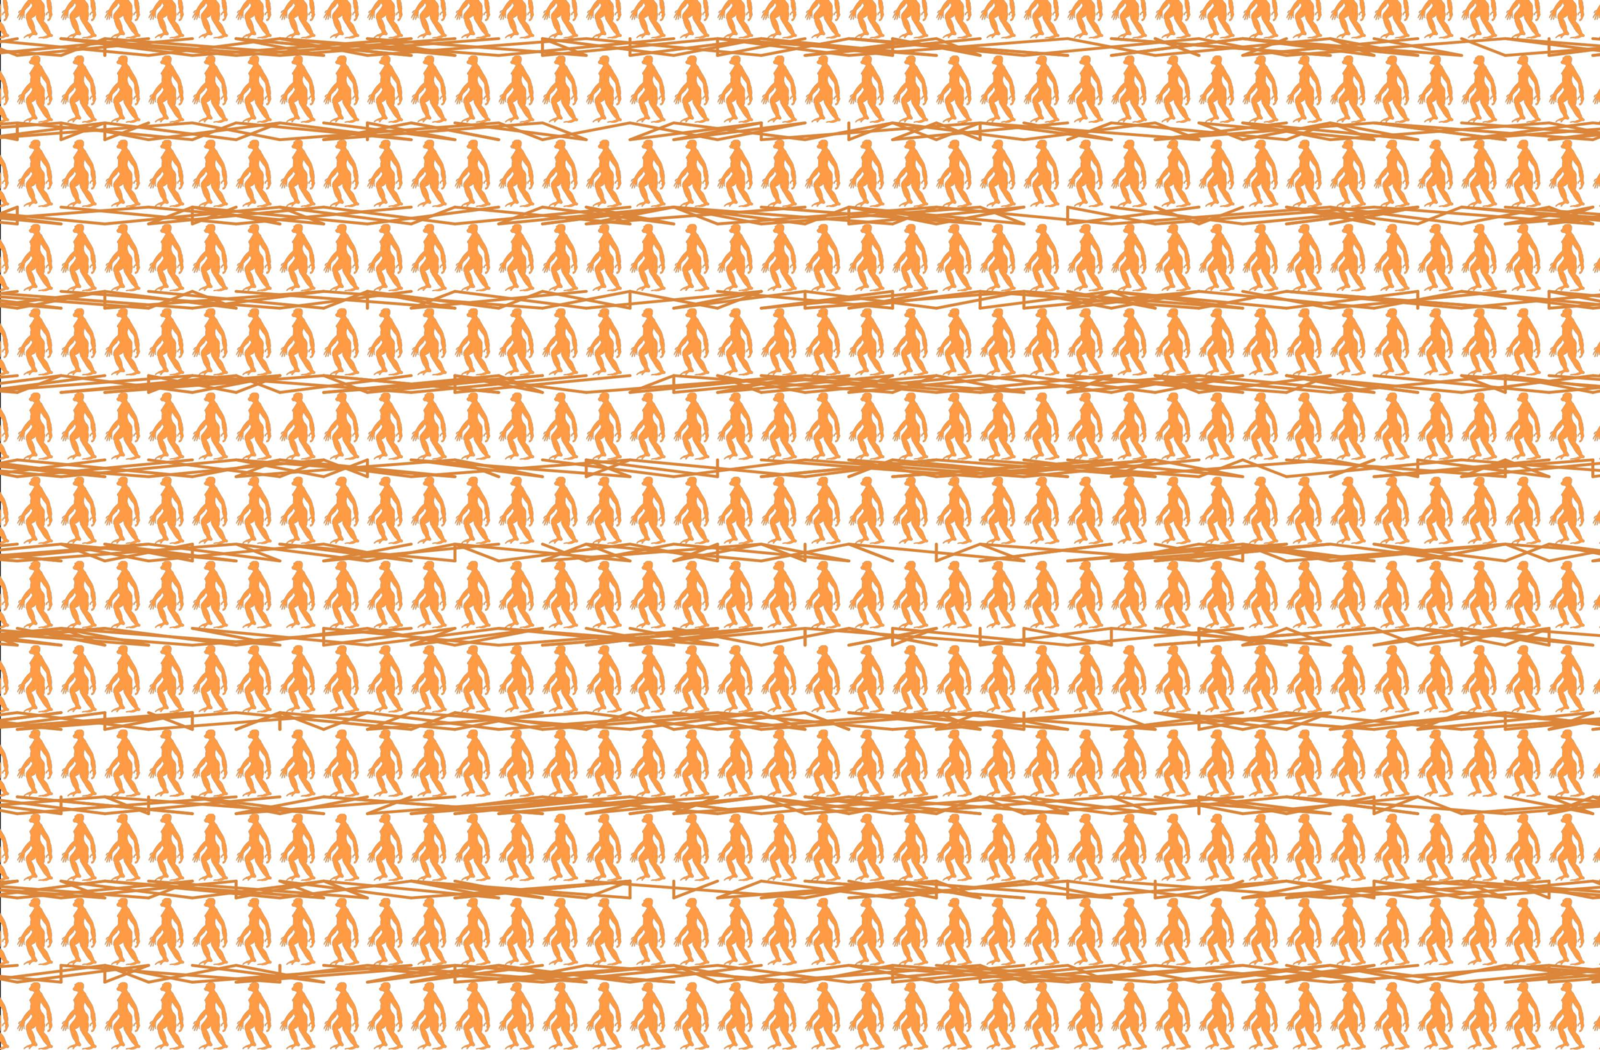
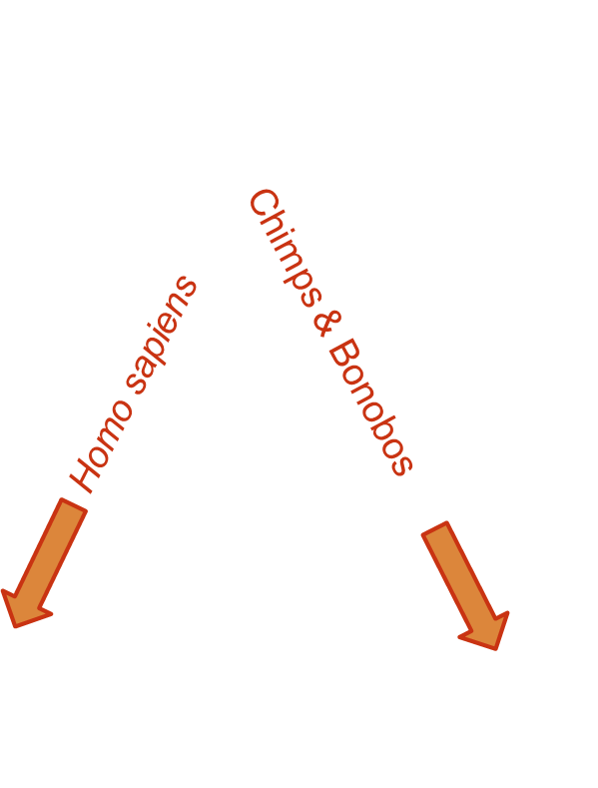
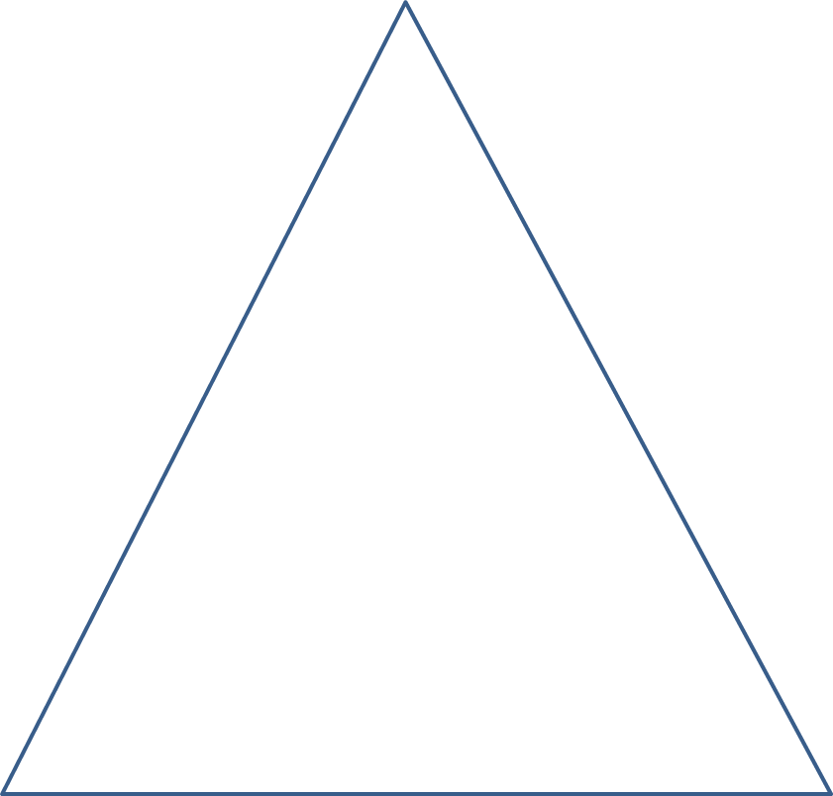
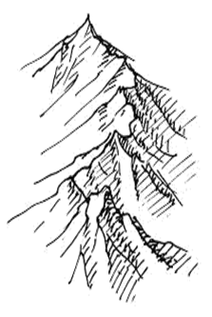
What happened here?

Slide 12
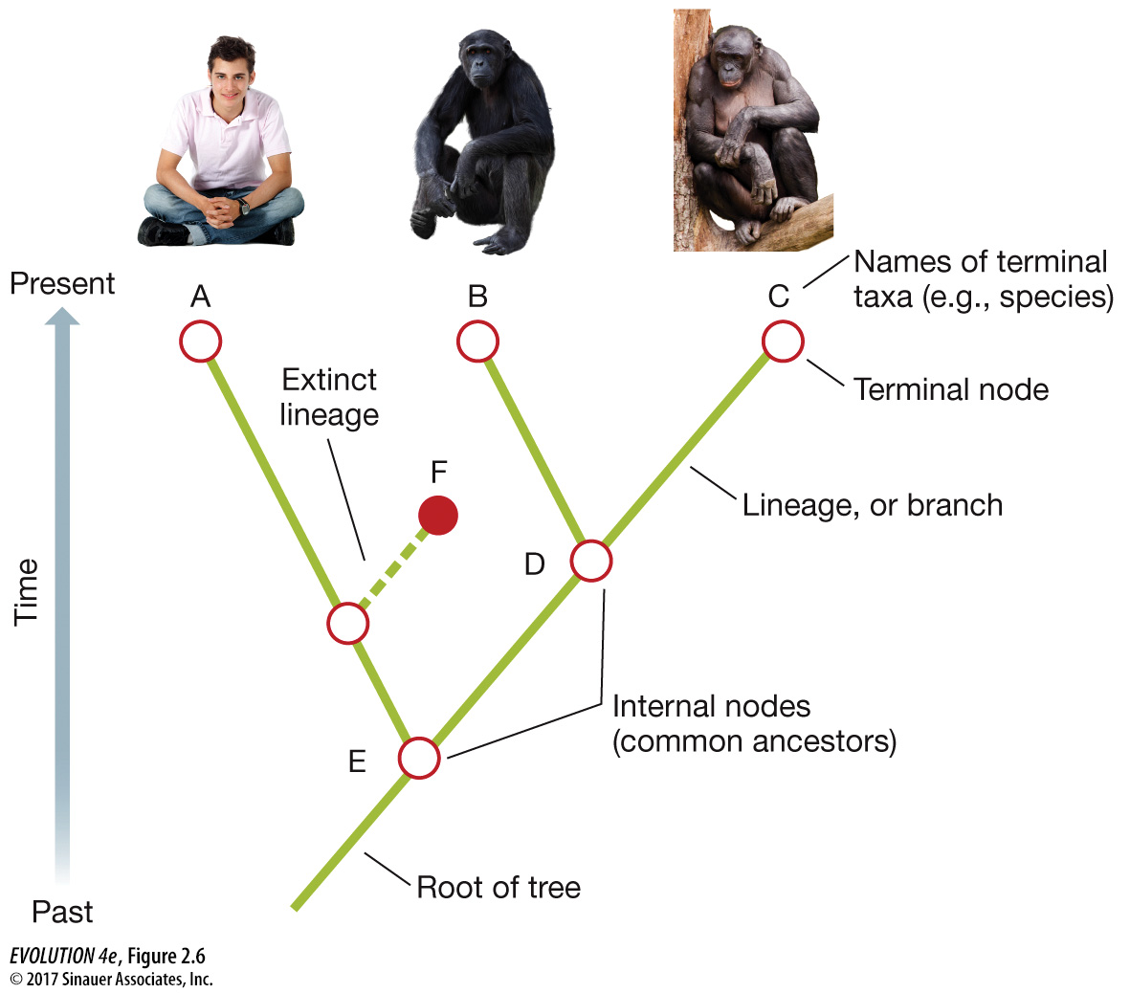
Terminology
Root Branch Node Tip Outgroup Clade Monophyletic Paraphyletic Polyphyletic

Slide 13
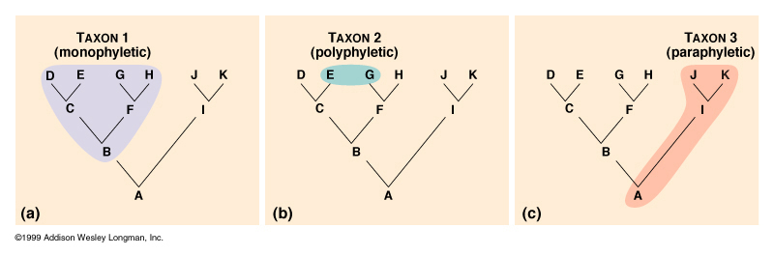
Taxonomy & Systematics Goal: Monophyly

Slide 14
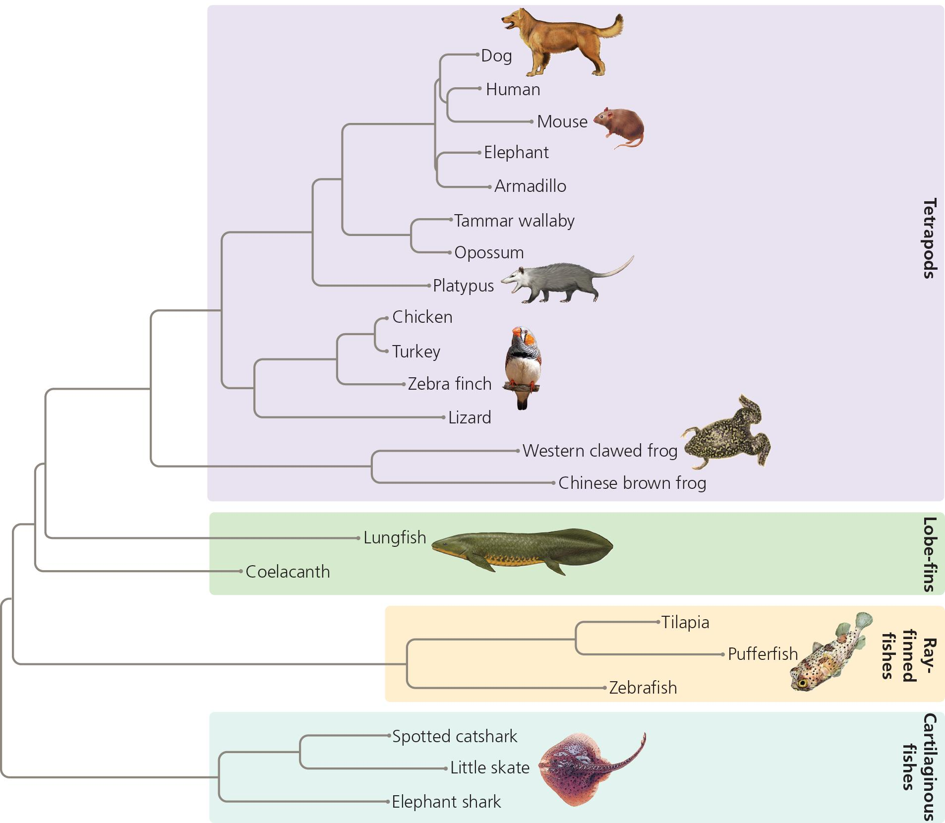
The phylogeny depicted clearly demonstrates that Lungfish are basal to /more primitive than frogs
True
False

Slide 15
Assignment I: Canvas self-assessment
Read Baum & Smith, and complete the questions in Assignment I. If you are registered in the class, you can take a canvas quiz (retake up to 10 times until you get 100%) to assess your understanding.
I'm going to assume you understand basic terminology and can read & interpret trees going forward.

Slide 16
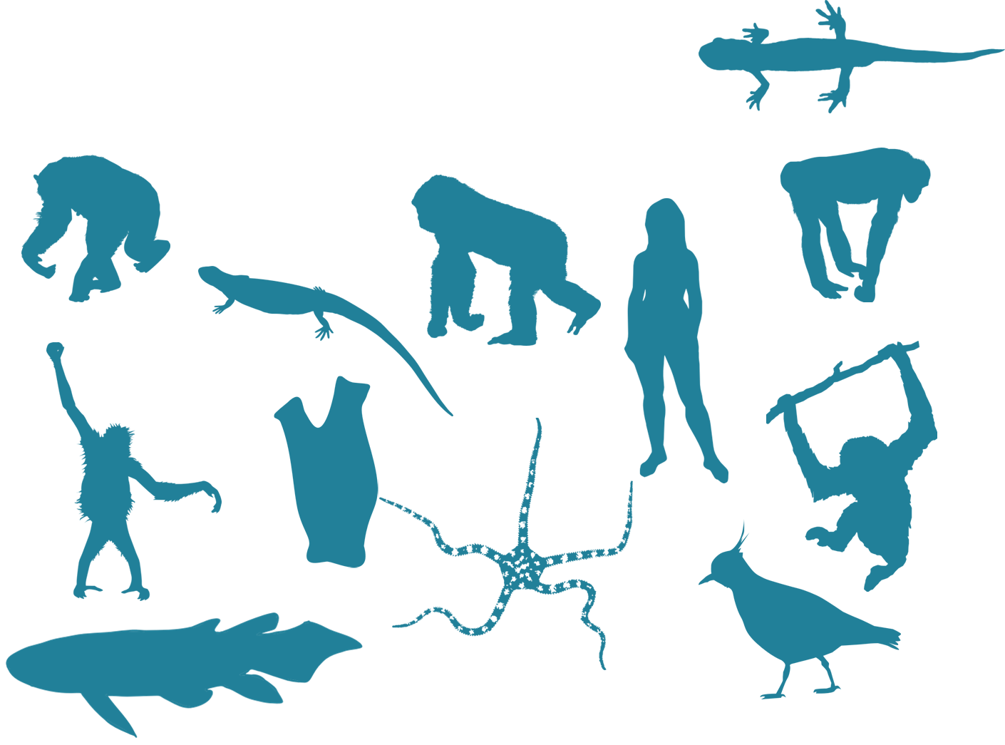
Going backwards-
Inferring phylogeny

Slide 17
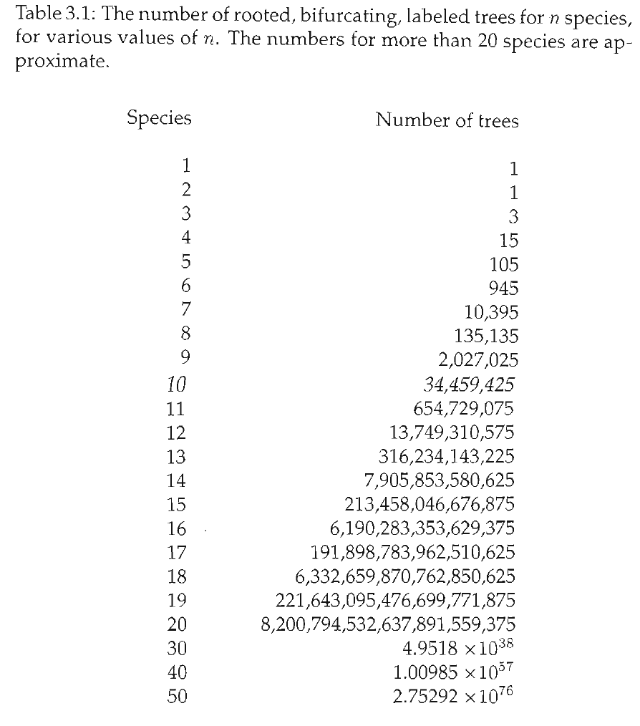
Tree space is huge!!

Slide 18
How can we find the “true” tree? (Is there a true tree?!?)

Slide 19
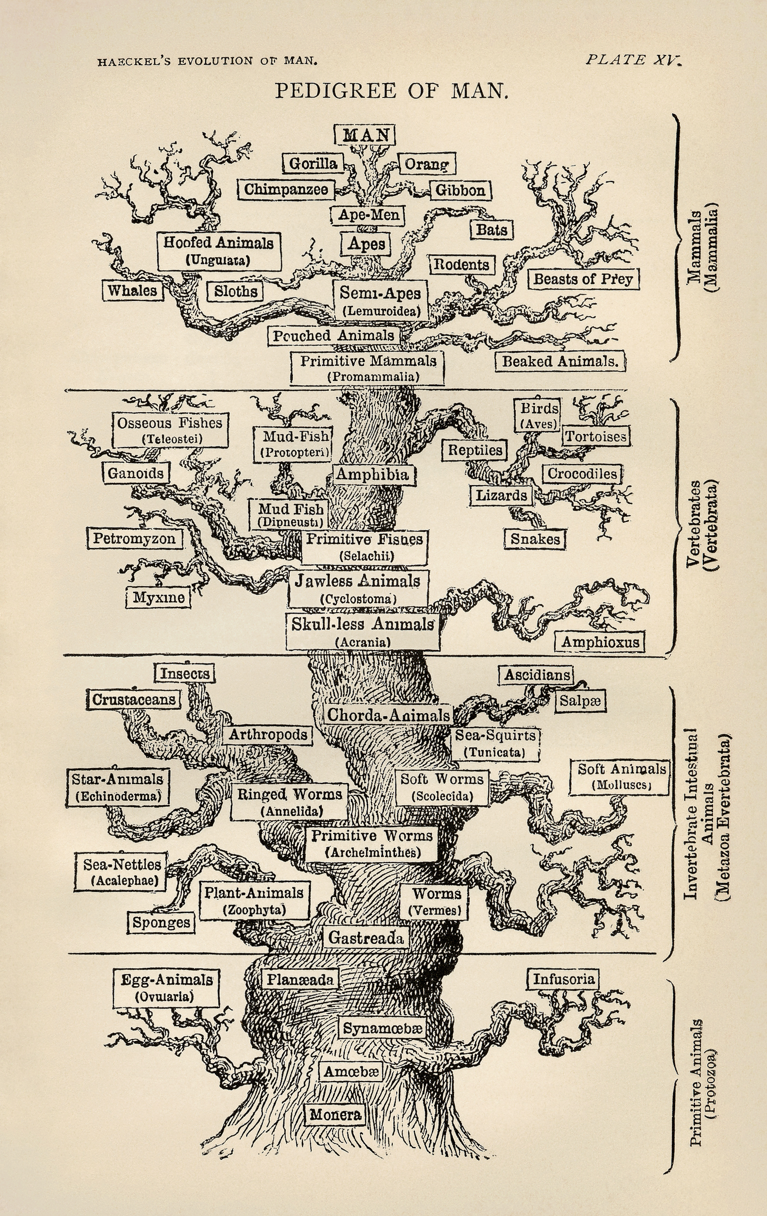
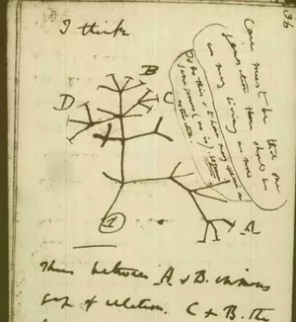
History of phylogenetic inference

Slide 20

History of phylogenetic inference
Evolutionary Taxonomy
Phenetics
Cladistics
Statistical Phylogenetics

Slide 21
History of phylogenetic inference: Evolutionary Taxonomy
No objective methodology
Relies on expert opinion & a lifetime of study

Slide 22
History of phylogenetic inference: Phenetics
Numerical Taxonomy & distance methods - measure overall similarity
How do you measure similarity?
What are the drawbacks of this approach?
Sokal, Sneath & Rohlf (1960's) argued phenetics provided much needed reproducibility

Slide 23
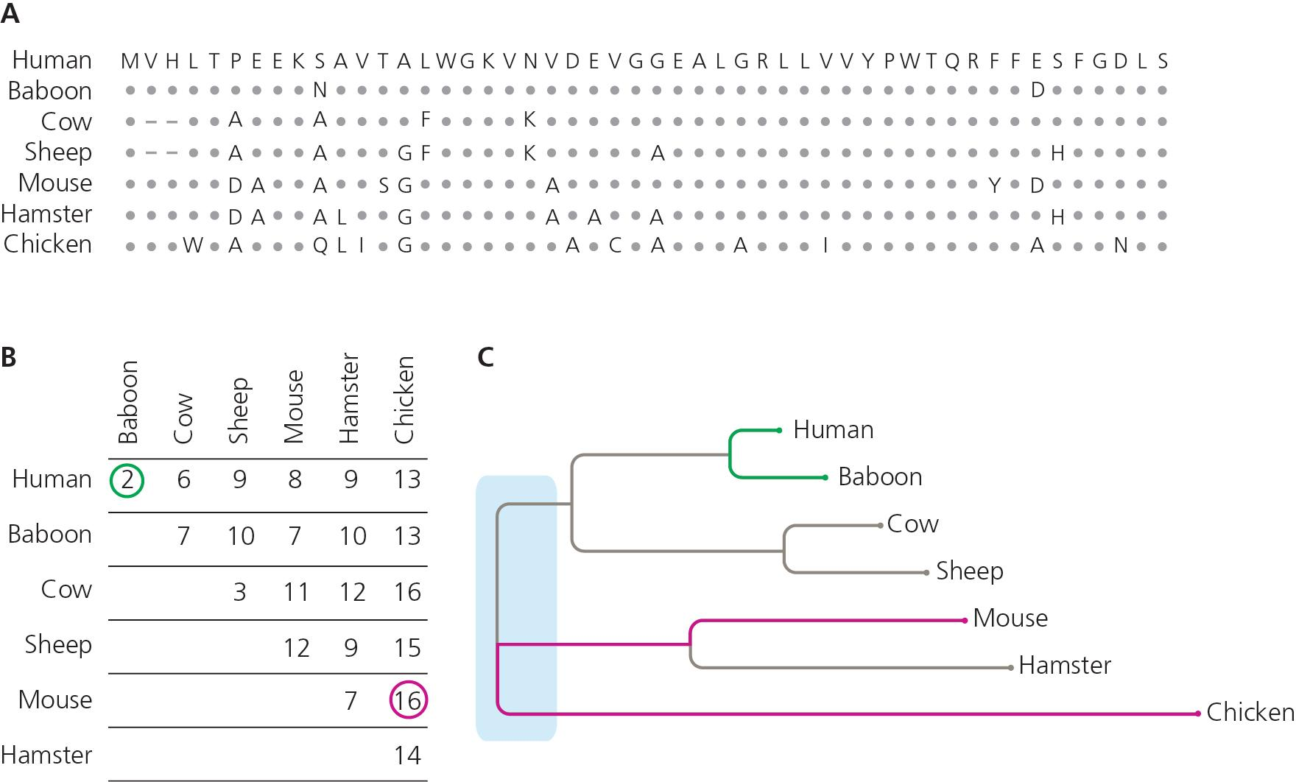

Slide 24
Next time: Parsimony & Cladistics

Slide 25
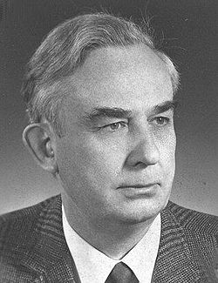
History of phylogenetic inference: Cladistics
"Phylogenetic systematics"
Argued that grouping should not be based on overall trait similarity, but only on shared derived traits (synapomorphies)
Taxonomy based on monophyly
Parsimony & Occam's Razor- The simplest explanation is probably the correct one
Willi Hennig (1966)

Slide 26
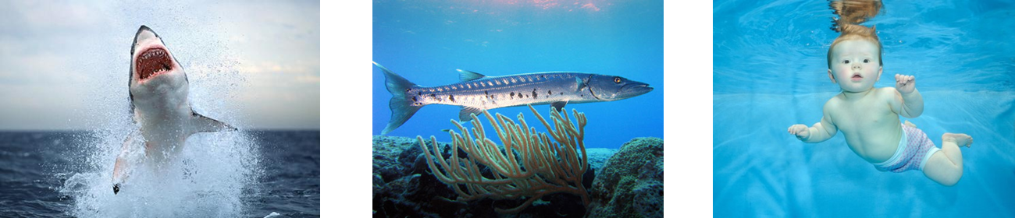
What’s the phylogenetic relationship?

Slide 27
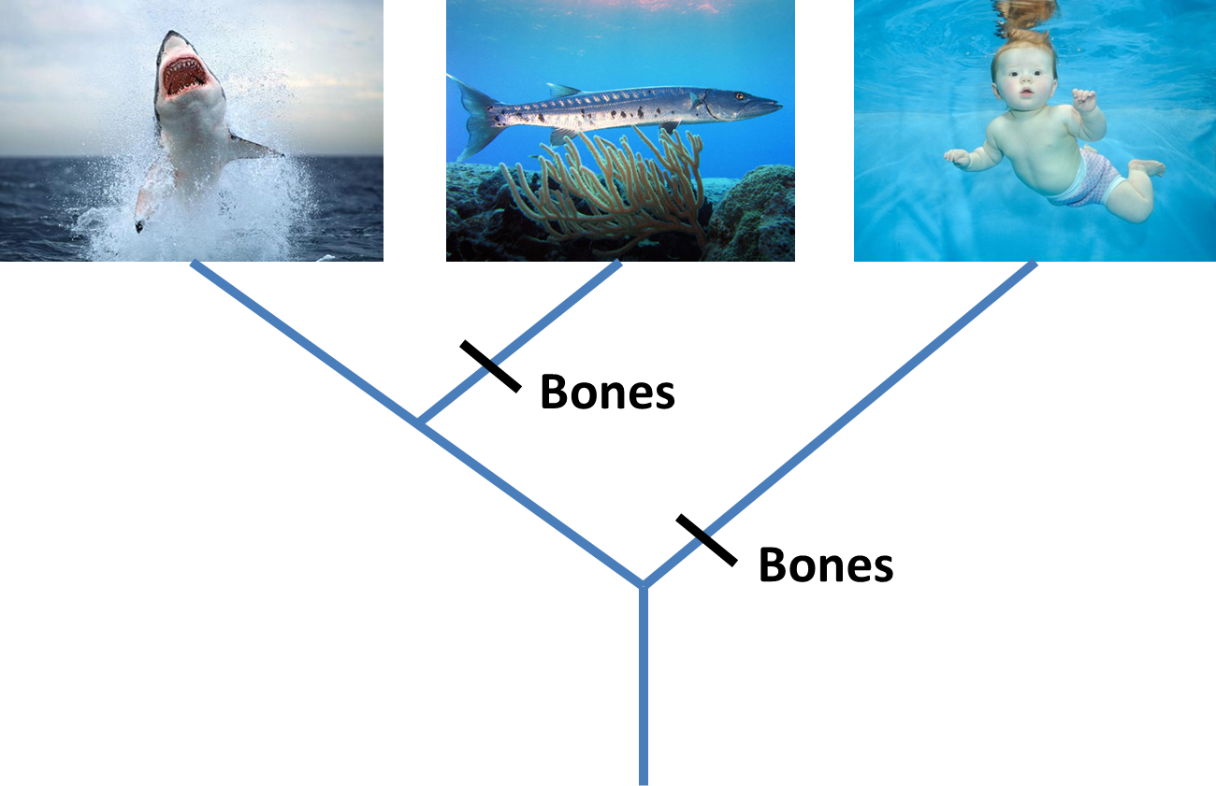

Slide 28
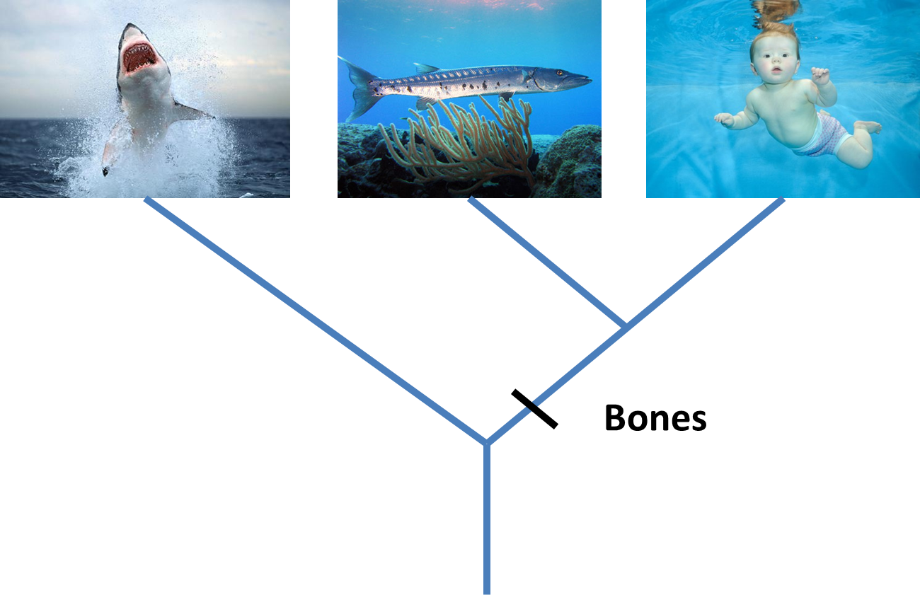
Parsimony

Slide 29
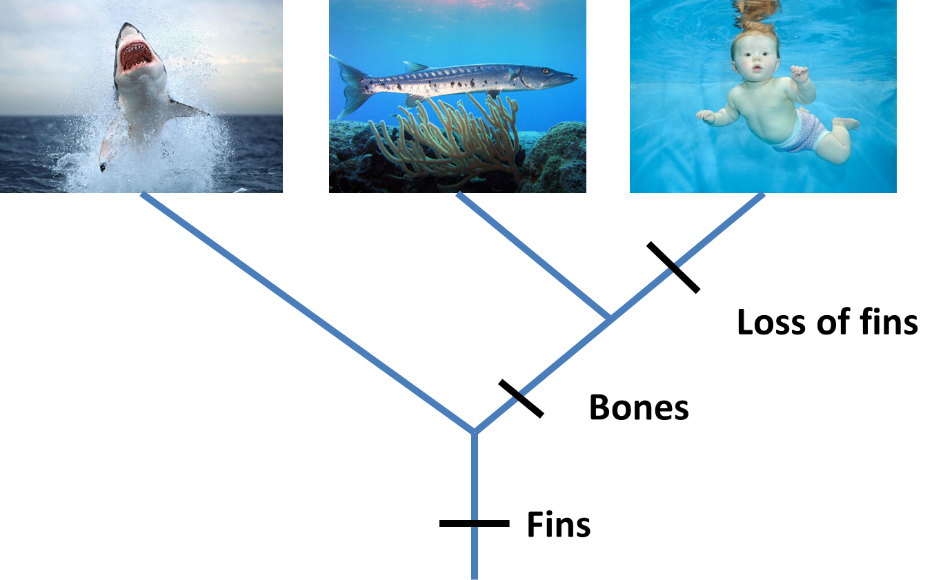

Slide 30
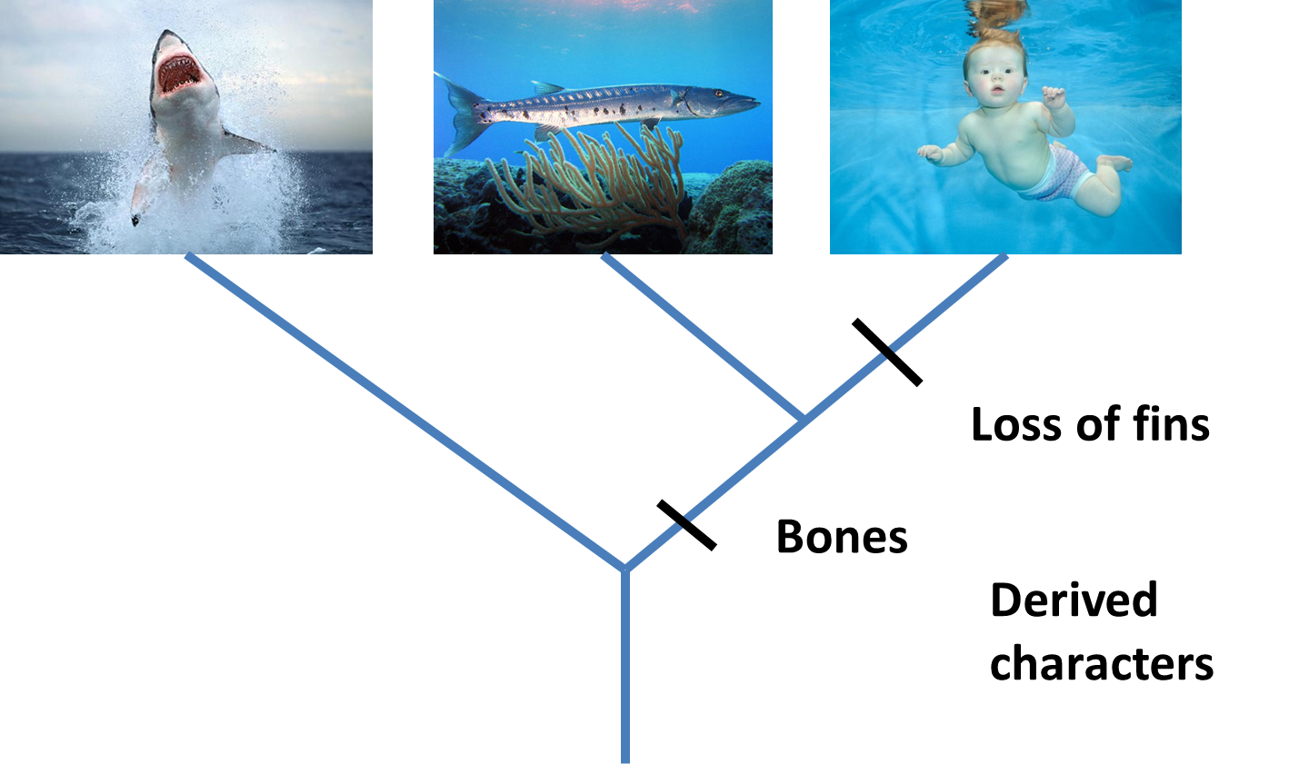
Derived Characters = Apomorphies

Slide 31
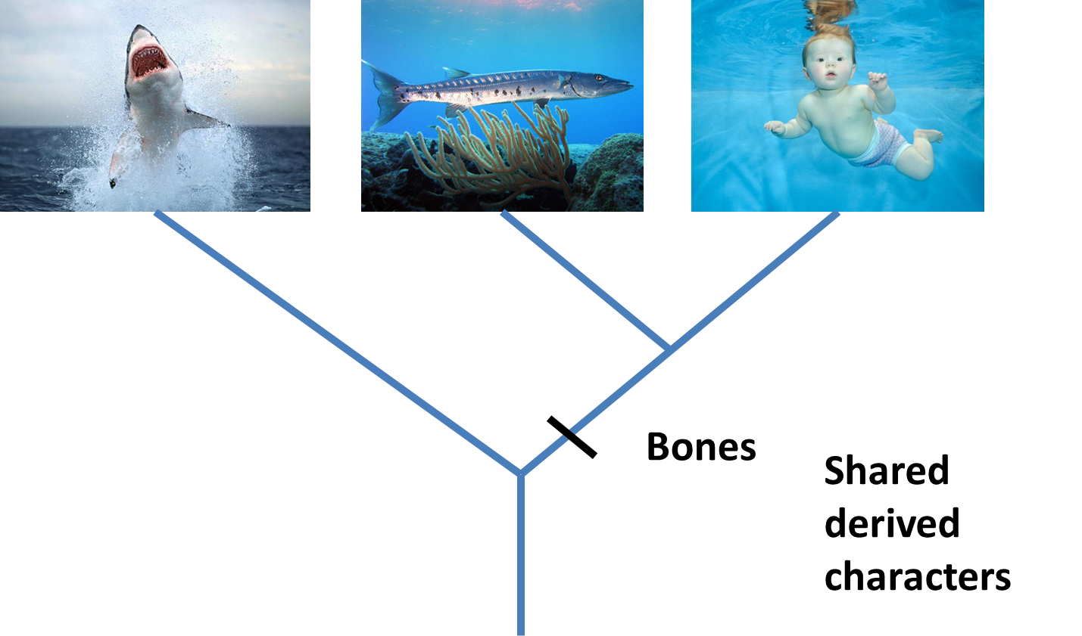
Shared derived characters = Synapomorphies

Slide 32

Shared ancestral characters = Symplesiomorphies

Slide 33
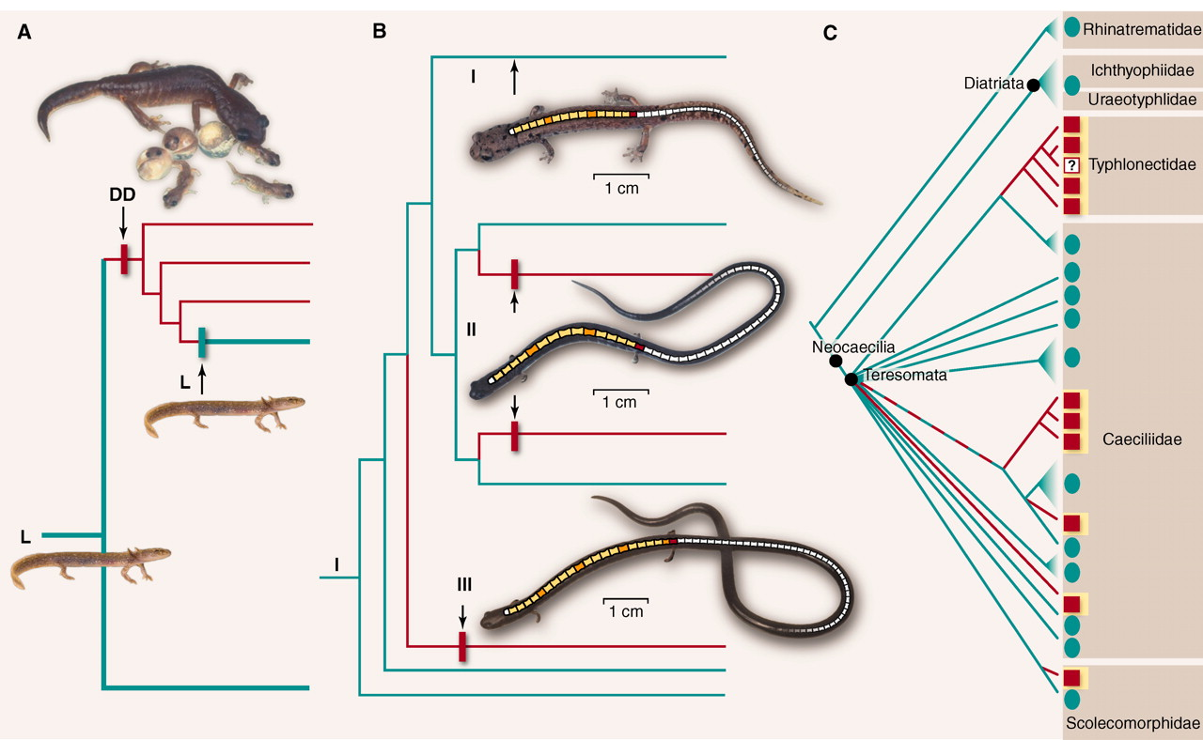
Conflict = Homoplasy

Slide 34
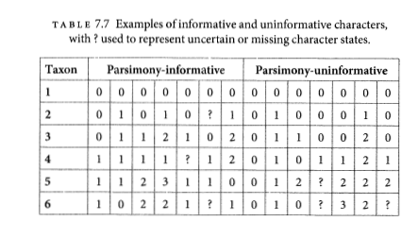
Parsimony informative vs. uninformative
Must have at least 2 taxa with shared traits in 2 different states.

Slide 35
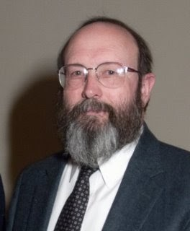
History of phylogenetic inference: Statistical phylogenetics
Luca Cavalli-Sforza, Anthony Edwards and later, Joseph Felsenstein
Probabilistic models of trait evolution
Showed statistical issues with parsimony, e.g. "the Felsenstein zone"
Maximum Likelihood & Bayesian inference
Joe Felsenstein

Slide 36
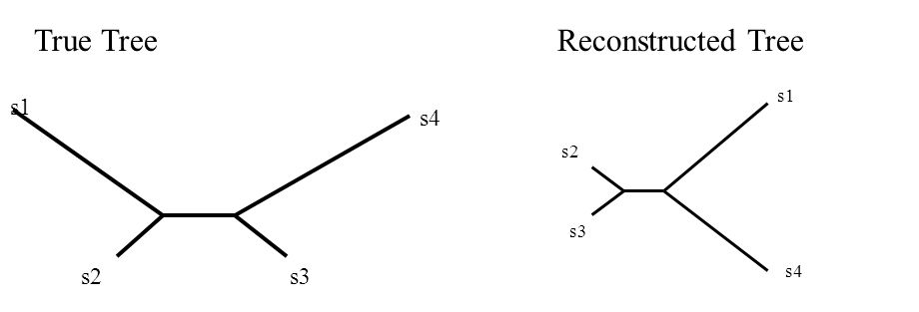
The Felsenstein Zone & "Long-branch attraction"
More generally, parsimony fell out of favor for molecular data due to more flexibility in incorporating substition models in statistical phylogenetics

Slide 37
Parsimony has unclear assumptions about evolution (rare changes, "no common mechanism")
Inconsistent estimator - An estimator that gets more and more certain of the wrong answer as more data is added

Slide 38
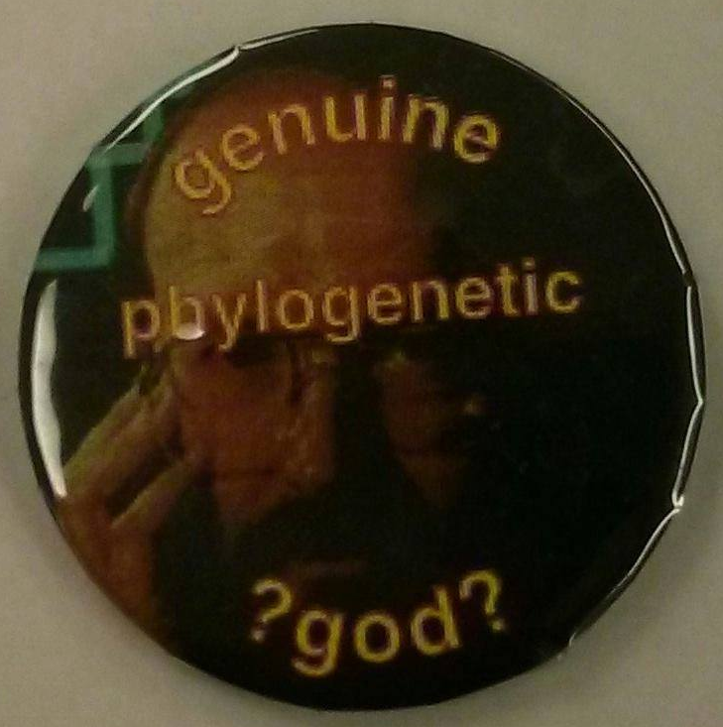
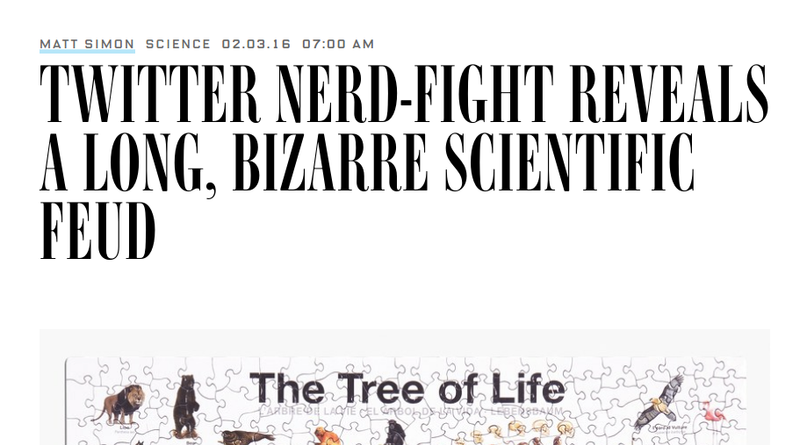
Conflict in science
#ParsimonyGate

Slide 39
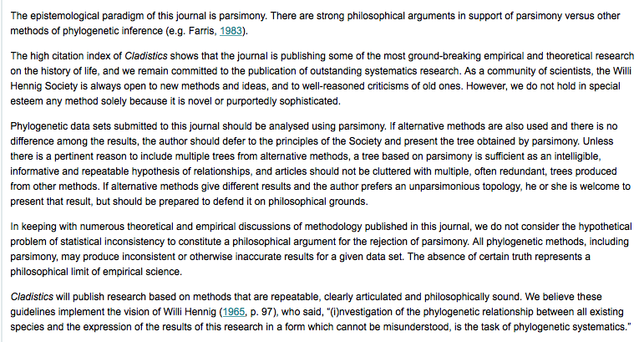

Slide 40
Parsimony still commonly used for:
Morphological analyses (though probabilistic models exist here too)
Starting trees
Understanding history of trait change

Slide 41
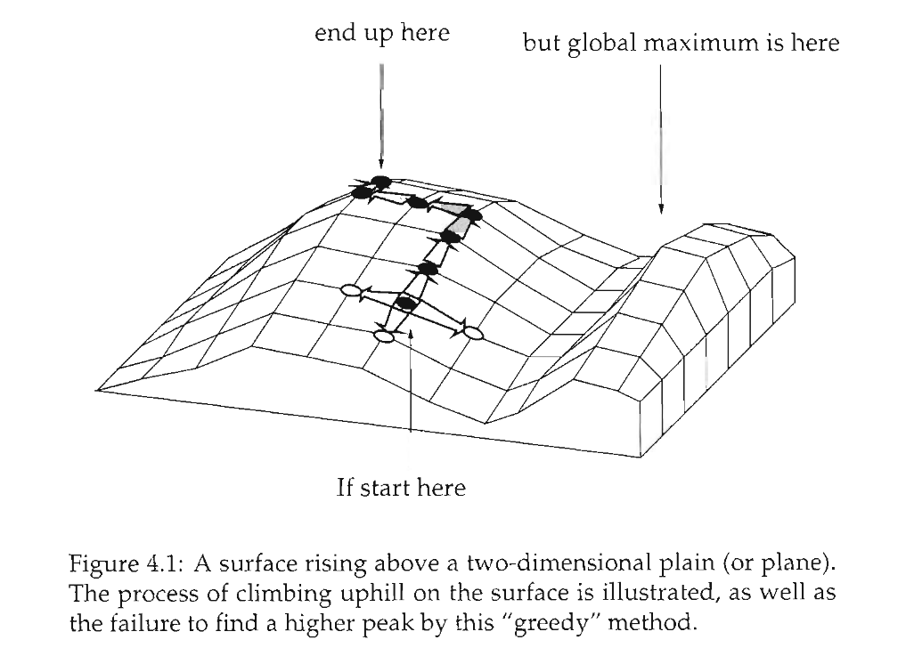
Heuristic searches

Slide 42
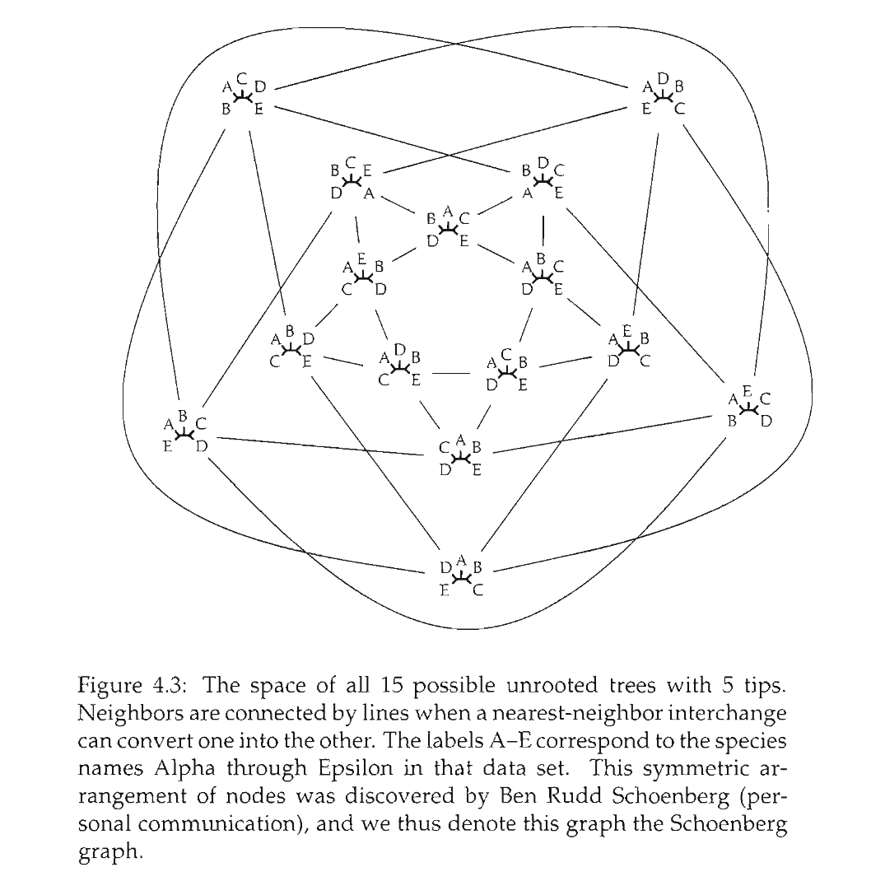

Slide 43
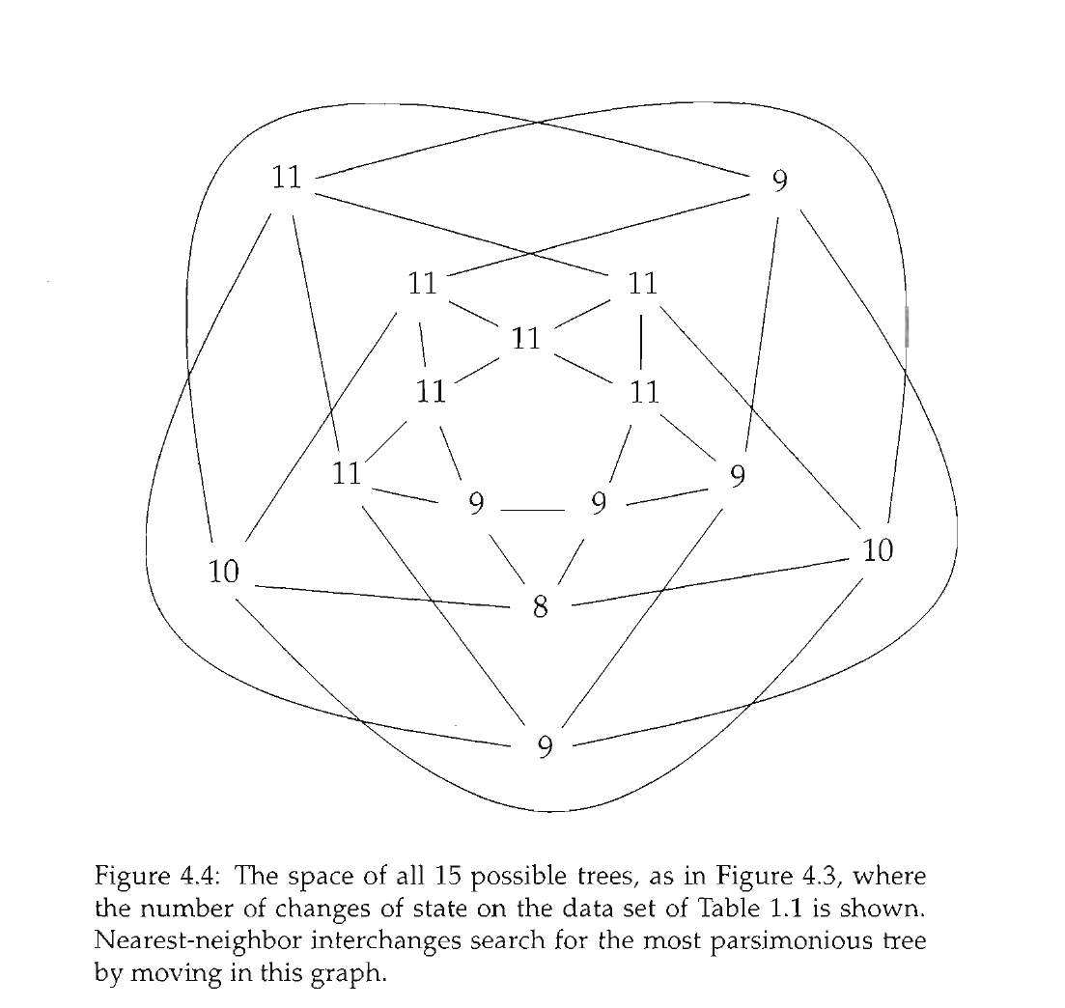

Slide 44
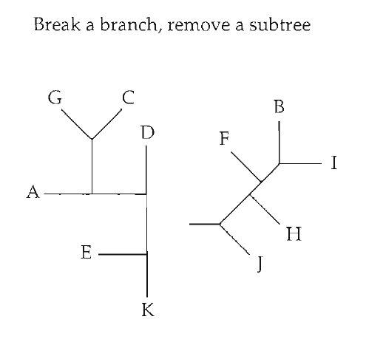
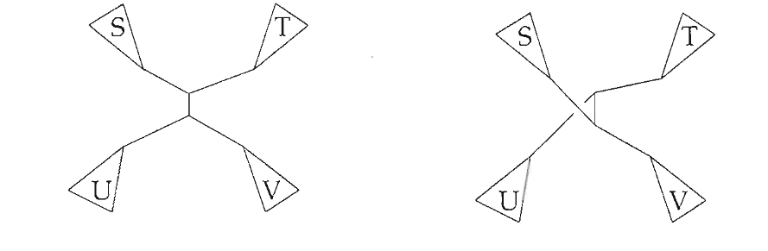
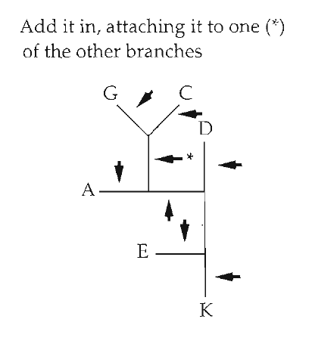
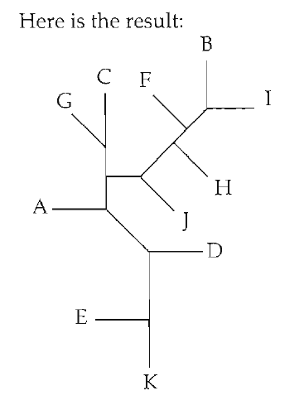
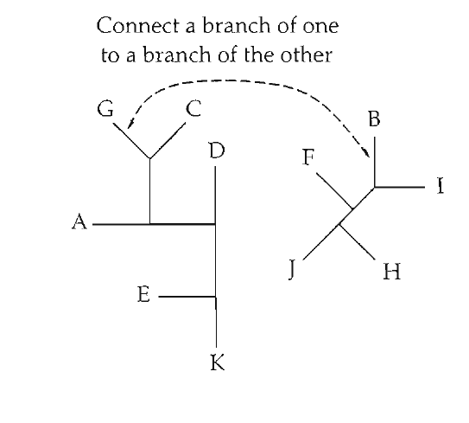
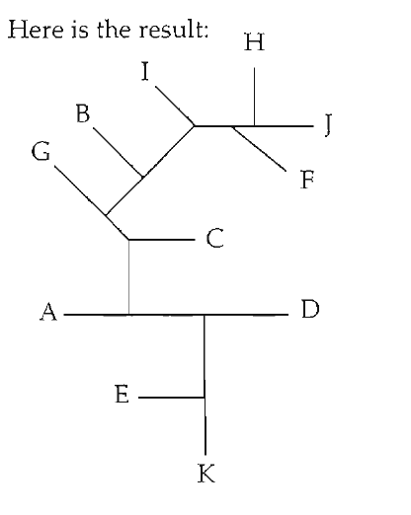
Tree space "moves"
Nearest Neighbor Interchange (NNI)
Tree bisection and reconnection (TBR)
Subtree pruning and regrafting (SPR)

Slide 45
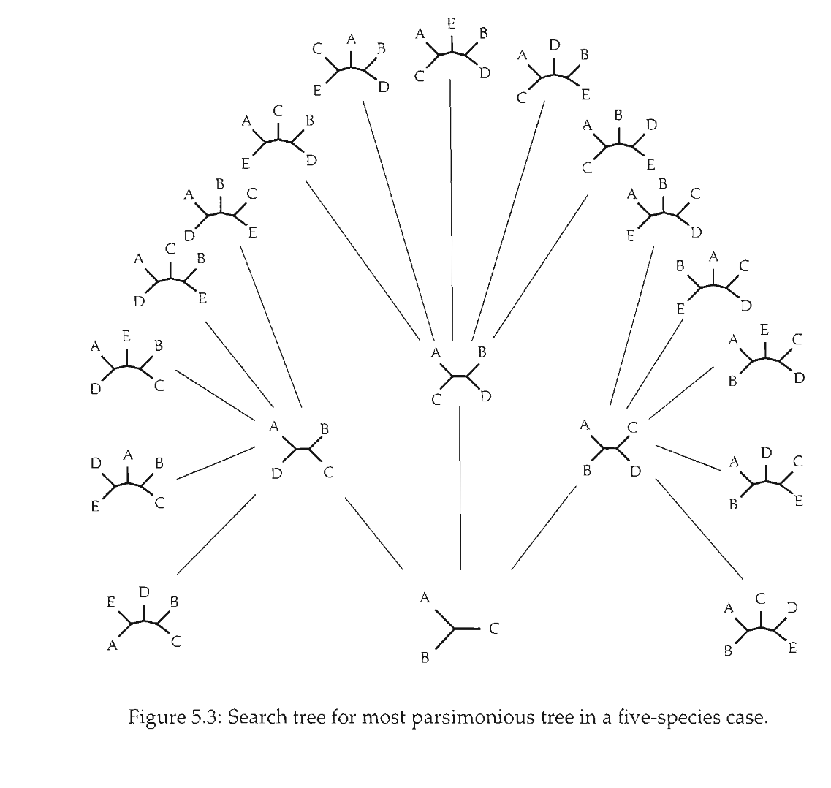
Branch and bound

Slide 46
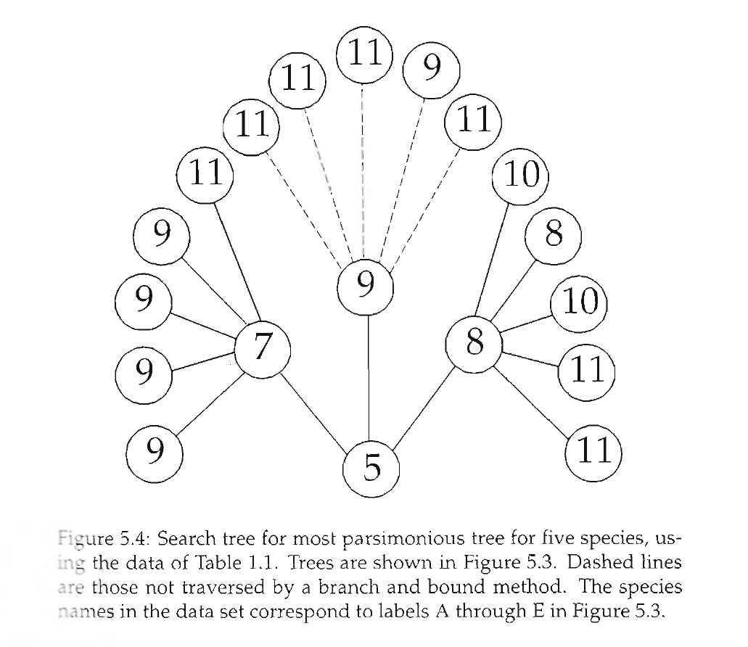
Branch and bound

Slide 47
Software: PAUP*, TNT, Mesquite, others...

